Slide 1
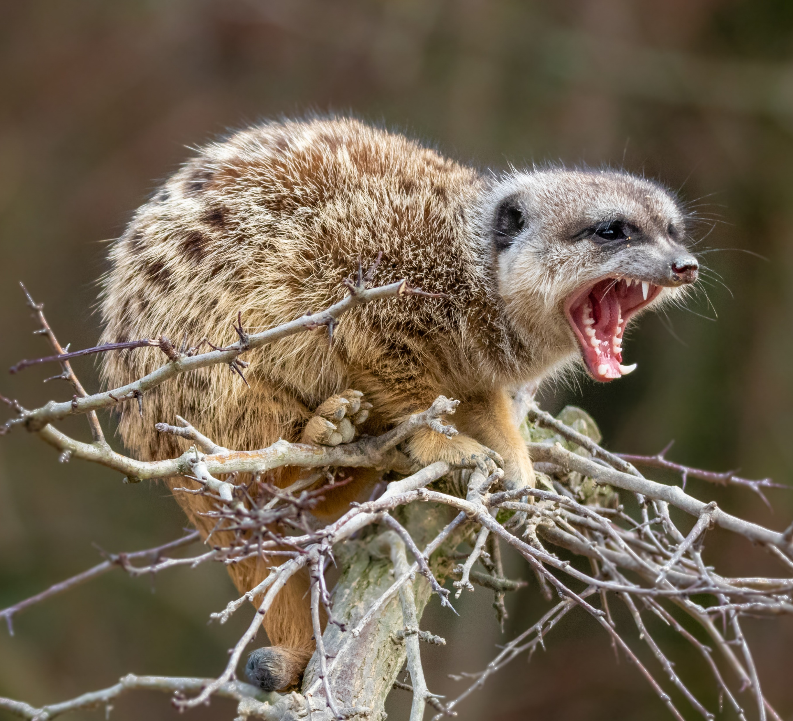
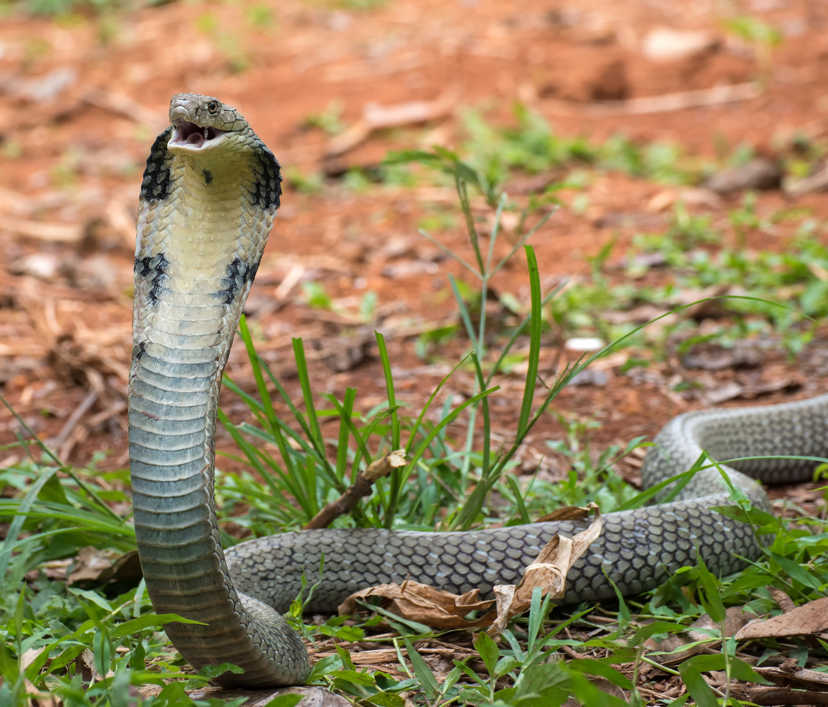
Mongoose v. Reptile
Jim Jarrow | Baker Sterchi Cowden & Rice LLC
Tierney Chadwick | Wadleigh, Starr & Peters, P.L.L.C
May 3, 2024

Slide 2
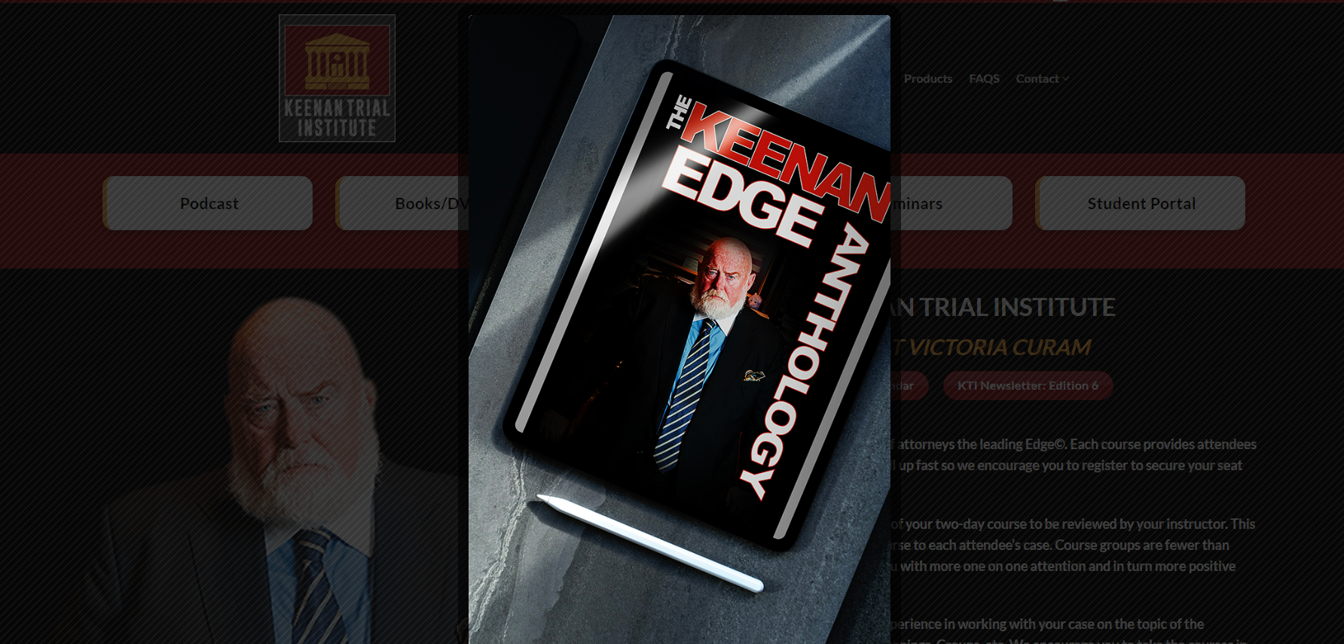
The Plaintiff’s Revolution

Slide 3
“It’s a cult.”

Slide 5
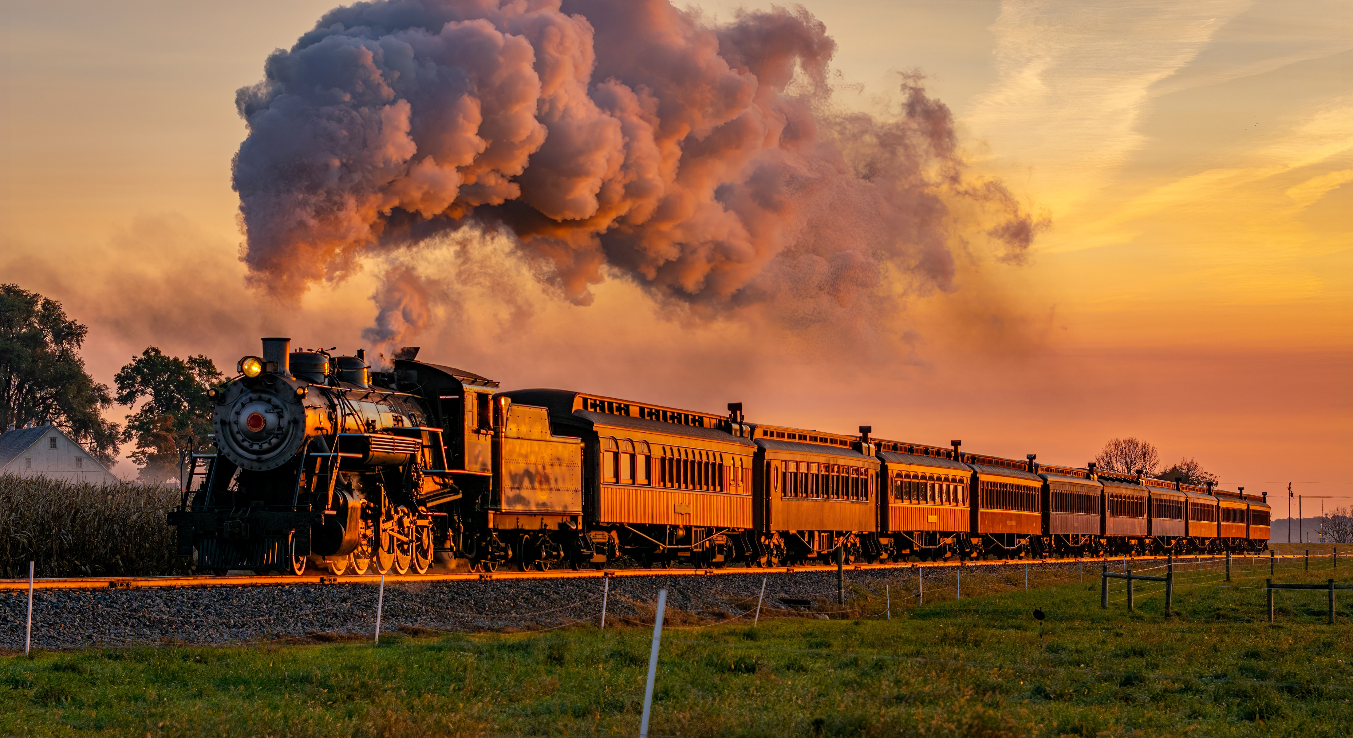
YES
YES
YES
YES
YES
YES
YES
YES
YES

Slide 6
REPTILE METHOD SQUENCING (DEATH SPIRIAL)
Q1: General Safety Rule Yes = dopamine response.
Q2: General Safety Rule
Q3: Hypothetical application of Safety Rule
Q4: Hypothetical application of Safety Rule
Q5: Hypothetical application of Safety Rule
Q6: Case Specific bad fact (contradiction flight, fear may lead to improper Yes answer)
Q7: Case Specific bad fact
Q8: Case Specific bad fact
Q9: Case Specific bad fact
Q10: Blame/Fault (Fear leads to fight, flight or freeze)

Slide 7
How to break the “yes” train

Slide 8
Plaintiff’s Counsel Quote
I can't live with it because “it depends”, doesn't lock anybody into anything.

Slide 9
Witness Preparation
Differs with sophisticated witness/non-sophisticated witness
When to prepare the witness?
How long to Prepare the witness?
Giving the witness the right tools.
Direct the witness to take notes during preparation.
Using Case Themes

Slide 10
“CASE THEMES”
PLAINTIFF’S | DEFENSE
PAUL WAS NEGLIGENT | PAUL ACTED REASONABLY, NOT NEGLIGENT
FAILED TO SEE HIM | LOOKED, SAW ONCOMING CAR FAR ENOUGH AWAY FOR ME TO SAFELY MAKE MY TURN WITHOUT RUSHING IT NO M/C HEADLIGHT/LIGHTS PRESENT.
M/C HAD RIGHT OF WAY; YIELD WHEN MAKING LEFT TURN | I HAVE TO YIELD TO VEHICLES IN INTERSECTION AND ANY VEHICLE APPROACHING IN OPPOSITE DIRECTION SO CLOSE AS TO BE AN IMMEDIATE HAZARD
YOU KILLED M/C DRIVER | LOSS OF LIFE TRAGIC, ….

Slide 11
Prepare the witness for absurd questions
Do you agree you should not unreasonably endanger members of the general public when driving your truck?

Slide 12
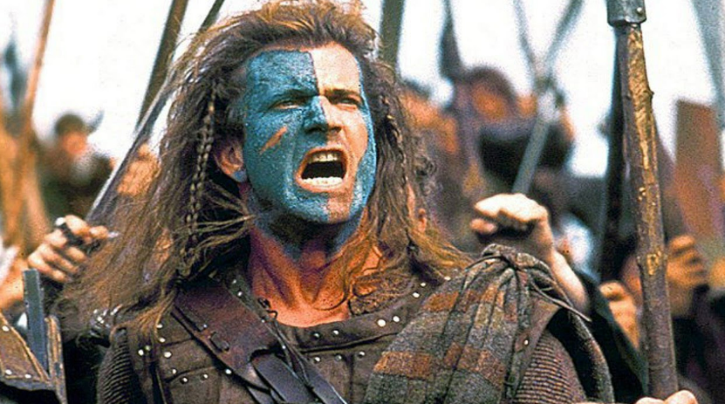
Case Battles Are Being Won/Lost in Depositions

Slide 13
Attorney Preparation Before Witness Preparation
What topflight Plaintiffs counsel do…
Nationally Recognized Plaintiff’s counsel quote, “ I spend 3 to 5 days preparing for every deposition.”
I review multiple prior corporate representative deposition transcripts from prior cases.
What topflight Defense attorneys do…
Network with other ALFA attorneys…
Obtain prior transcripts from depos Plaintiff’s counsel has taken in other cases.
Obtain prior deposition transcripts of Company’s corporate rep depos.

Slide 14
Mock Depositions
How?
Every witness fails the mock.
Tearing down and building up.
If done correctly, the witness will get stronger.

Slide 15
Question at a Recent Seminar
Can you really prepare a truck driver to deal with the reptile attack?

Slide 16
Questions?

