Slide 2
All Aboard! Hopping on the Diversity, Equity and Inclusion Bus Before You Get Left at the Station

Slide 3
What is Considered “Diverse?”
ABA examines diversity through following categories:
      Gender
      Race or ethnicity
      Sexual orientation or identification
      Disabilities
      Religion
      Age
      National origin
      Military service

Slide 4
Are we there yet?
A 2019 study of over 1,000 offices of major law firms in the US found that in 2018:
-Women comprised 35.41 percent of the attorneys at those firms
-16.1 percent of attorneys were racially or ethnically diverse
-8.08 percent were racially or ethnically diverse women
-2.86 percent were LGBTQ attorneys
-0.53 percent were attorneys with disabilities.

Slide 5
Why Does It Matter?
More Diverse Viewpoints and Well Rounded Teams
      Different Perspectives
      Different Viewpoints
      Different Experiences
      Different Opinions
Results in More Innovative, Creative, and Collaborative Teams
      Consider Factors and Issues Previously Overlooked, Undervalued, or Dismissed

Slide 6
The Current Scorecard
What are You Currently Doing?
What is Working? What is Not?
What is in the Pipeline?
Where does it fall on Priorities?

Slide 7
What Can I Do to Support DEI Efforts?
Actively have a DEI initiative and committee (in practice, not just name)
Training and education programs
Recruiting in non-traditional places/Hiring new people
Participation in diversity initiatives, client’s diversity activities, or bar association programs or community initiatives
Selecting new law firms
Using new attorneys instead of the older, more comfortable people
Not just optional/after work/off the clock activities

Slide 8
Who Really Cares Anyway?
Clients
Jurors
Mediators
Employees
Future Employees
Public
Your Pocketbook

Slide 9
The Clients Say they Care,
But do they Really?
Complaints about “Pitch Teams”
-All talk, No Action Promotional Materials
Honesty About Shortcomings
Active Recruiting Efforts
ERG Programs, Mentoring, etc.
Not looking for Staffing Quotas
    -Hurts Clients, Bottom Line, and that Person’s Development
Seats at the Table not just Entry through the Door

Slide 10
What If It Still Seems Like Too Much Effort?
Not a Fad
Not a Political Statement
Large Impacts
    -Clients (Law Firms)
    -Jury Verdicts
    -Public Perception
    -Employee Retention and Happiness
    -Mediation Results
    -Future Efforts

Slide 11
I Think My Company is Doing Well….
Always Room to Improve
Continually Changing
Never Mastered, Always a Work in Progress
Areas You Haven’t Thought About?
  -Prevalence increases when not currently diverse
  -Unconscious Bias?
What would the Scorecard Say?

Slide 12
Activity
1 minute
Circle Numbers in Numerical Order
Can’t Skip Any Numbers
Goal to Get as Many Numbers as Possible
No working with Neighbors

Slide 13
Unconscious Bias
Unconscious, not deliberate
Stereotyped beliefs and attitudes
  -Positive and Negative
No Group Excluded
-Underrepresented Groups too
-Stereotypes about Common Kind
Media and Culturally Reinforced

Slide 14
Jennifer v. John Study
2012 Study
  -127 STEM professors from 6 major labs, all genders, ethnicities
  -Identical resumes sent on the substance
  -Names at the top altered
Same Qualifications, Different Results
  -John’s rating 4.0
  -Jennifer’s Rating 3.3
  -John’s Offer $30,328
  -Jennifer’s Offer $26,508

Slide 15
Steven v. Raj
2014 Study
Emails to 6,500 PhD professors, 259 universities
Included White Fe/Males and Racially Diverse Fe/Males
Same Email, Different Name/Email Address
    -Steven Smith, Brad Anderson 2x responses
    -Keisha Thomas, Raj Singh, Dong Lin, Juanita Martinez
Universal, not just by White Male Professors

Slide 16
The Study of Thomas
2014 Study
See what we Expect, Ignore what contradicts
Research Memo Drafted by several attorneys on Trade Secrets
Distributed to 60 partners, 22 law firms
-Thomas Meyer, NYU Grad White 50%/Black 50%
-Scale of 1-5 Rating and Error Review
53 Evals returned (24 Black/29 White)
-(B) 3.2/5.0, (W) 4.1/5.0
-Twice as Many Errors, More Critical Comments
Across the board results regardless of gender and race
Other studies confirm this happens with activities on resumes, cities lived in, etc. that indicate socioeconomic status, disability, sexual preference, etc.

Slide 17
Combatting Unconscious Bias
Awareness
  -Perpetual “Why?”
  -Quizzes
  -Monitoring Surprises
  -Tracking Discomfort
Acceptance
    -Doesn’t Make you “Bad”
Behavioral Changes
-Retraining the Brain
-Embracing the Non-Stereotype
-Actively Doubt Objectivity
Cross-Different Relationships
Mix it Up
Find Commonalities
Reduce Fatigue, Stress, Time Crunches

Slide 18
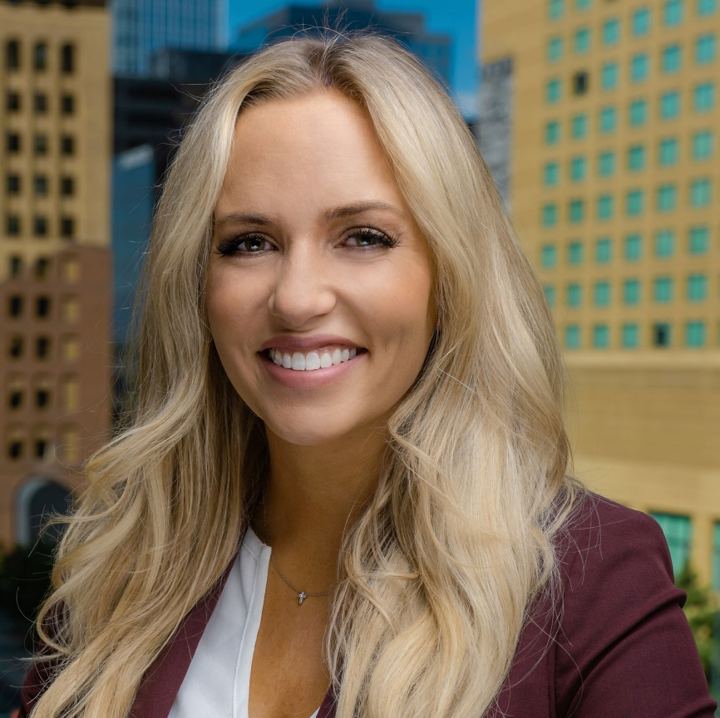
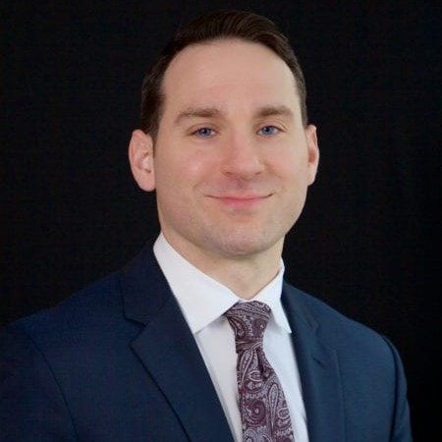
Thank you!
Brooke Churchman
HALL & EVANS
Denver, Colorado
Matt McColgan
GERMAN, GALLAGHER & MURTAGH, P.C.
Philadelphia, Pennsylvania

